Slide 1
Chapter 7 – Risk management
SOFTWARE
PROJECT MANAGEMENT

Slide 2
Risk management
This lecture will touch upon:
Definition of ‘risk’ and ‘risk management’
Some ways of categorizing risk
Risk management
  Risk identification – what are the risks to a project?
  Risk analysis – which ones are really serious?
  Risk planning – what shall we do?
  Risk monitoring – has the planning worked?
We will also look at PERT risk and critical chains
Notes:
Topics covered
Professional software development
What is meant by software engineering.
Software engineering ethics
A brief introduction to ethical issues that affect software engineering.
Suggested student projects
A brief introduction to each suggested project that can be carried out by students for this course

Slide 3
Some definitions of risk
‘the chance of exposure to the adverse consequences of future events’ PRINCE2
‘an uncertain event or condition that, if it occurs, has a positive or negative effect on a project’s objectives’ PM-BOK
Risks relate to possible future problems, not current ones
They involve a possible cause and its effect(s) e.g. developer leaves > task delayed
Notes:
Topics covered
Professional software development
What is meant by software engineering.
Software engineering ethics
A brief introduction to ethical issues that affect software engineering.
Suggested student projects
A brief introduction to each suggested project that can be carried out by students for this course

Slide 4
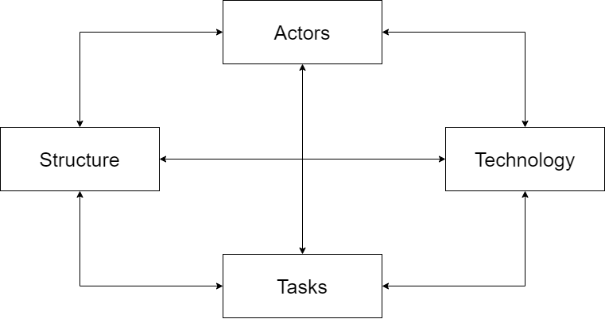
Categories of risk
Notes:
Topics covered
Professional software development
What is meant by software engineering.
Software engineering ethics
A brief introduction to ethical issues that affect software engineering.
Suggested student projects
A brief introduction to each suggested project that can be carried out by students for this course

Slide 5
A framework for dealing with risk
The planning for risk includes these steps:
Risk identification – what risks might there be?
Risk analysis and prioritization – which are the most serious risks?
Risk planning – what are we going to do about them?
Risk monitoring – what is the current state of the risk?
Notes:
Topics covered
Professional software development
What is meant by software engineering.
Software engineering ethics
A brief introduction to ethical issues that affect software engineering.
Suggested student projects
A brief introduction to each suggested project that can be carried out by students for this course

Slide 6
Risk identification
Approaches to identifying risks include:
Use of checklists – usually based on the experience of past projects
Brainstorming – getting knowledgeable stakeholders together to pool concerns
Causal mapping – identifying possible chains of cause and effect
Notes:
Topics covered
Professional software development
What is meant by software engineering.
Software engineering ethics
A brief introduction to ethical issues that affect software engineering.
Suggested student projects
A brief introduction to each suggested project that can be carried out by students for this course

Slide 7
Boehm’s top 10 development risks
Risk | Risk reduction techniques
Personnel shortfalls | Staffing with top talent; job matching; teambuilding; training and career development; early scheduling of key personnel
Unrealistic time and cost estimates | Multiple estimation techniques; design to cost; incremental development; recording and analysis of past projects; standardization of methods
Notes:
Topics covered
Professional software development
What is meant by software engineering.
Software engineering ethics
A brief introduction to ethical issues that affect software engineering.
Suggested student projects
A brief introduction to each suggested project that can be carried out by students for this course

Slide 8
Boehm’s top 10 development risks
Risk | Risk reduction techniques
Developing the wrong software functions | Improved software evaluation; formal specification methods; user surveys; prototyping; early user manuals
Developing the wrong user interface | Prototyping; task analysis; user involvement
Notes:
Topics covered
Professional software development
What is meant by software engineering.
Software engineering ethics
A brief introduction to ethical issues that affect software engineering.
Suggested student projects
A brief introduction to each suggested project that can be carried out by students for this course

Slide 9
Boehm’s top ten risk - continued
Gold plating | Requirements scrubbing, prototyping, design to cost
Late changes to requirements | Change control, incremental development
Shortfalls in externally supplied components | Benchmarking, inspections, formal specifications, contractual agreements, quality controls
Notes:
Topics covered
Professional software development
What is meant by software engineering.
Software engineering ethics
A brief introduction to ethical issues that affect software engineering.
Suggested student projects
A brief introduction to each suggested project that can be carried out by students for this course

Slide 10
Boehm’s top ten risk - continued
Gold plating | Requirements scrubbing, prototyping, design to cost
Shortfalls in externally performed tasks | Quality assurance procedures, competitive design etc
Real time performance problems | Simulation, prototyping, tuning
Development technically too difficult | Technical analysis, cost-benefit analysis, prototyping , training
Notes:
Topics covered
Professional software development
What is meant by software engineering.
Software engineering ethics
A brief introduction to ethical issues that affect software engineering.
Suggested student projects
A brief introduction to each suggested project that can be carried out by students for this course

Slide 11
Risk prioritization
Risk exposure (RE) = (potential damage) x (probability of occurrence) Ideally
Potential damage: a money value e.g. a flood would cause £0.5 millions of damage
Probability 0.00 (absolutely no chance) to 1.00 (absolutely certain) e.g (one in hundred chance)
RE = £0.5m x 0.01 = £5,000
Crudely analogous to the amount needed for an insurance premium
Notes:
Topics covered
Professional software development
What is meant by software engineering.
Software engineering ethics
A brief introduction to ethical issues that affect software engineering.
Suggested student projects
A brief introduction to each suggested project that can be carried out by students for this course

Slide 12
Risk probability: qualitative descriptors
Probability level | Range
High | Greater than 50% chance of happening
Significant | 30-50% chance of happening
Moderate | 10-29% chance of happening
Low | Less than 10% chance of happening
Notes:
Topics covered
Professional software development
What is meant by software engineering.
Software engineering ethics
A brief introduction to ethical issues that affect software engineering.
Suggested student projects
A brief introduction to each suggested project that can be carried out by students for this course

Slide 13
Qualitative descriptors of impact on cost and associated range values
Impact level | Range
High | Greater than 30% above budgeted expenditure
Significant | 20 to 29% above budgeted expenditure
Moderate | 10 to 19% above budgeted expenditure
Low | Within 10% of budgeted expenditure.
Notes:
Topics covered
Professional software development
What is meant by software engineering.
Software engineering ethics
A brief introduction to ethical issues that affect software engineering.
Suggested student projects
A brief introduction to each suggested project that can be carried out by students for this course

Slide 14
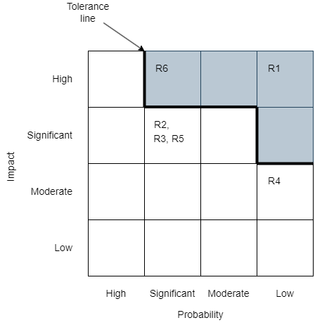
Probability impact matrix
Notes:
Topics covered
Professional software development
What is meant by software engineering.
Software engineering ethics
A brief introduction to ethical issues that affect software engineering.
Suggested student projects
A brief introduction to each suggested project that can be carried out by students for this course

Slide 15
Risk planning
Risks can be dealt with by:
Risk acceptance
Risk avoidance
Risk reduction
Risk transfer
Risk mitigation/contingency measures
Notes:
Topics covered
Professional software development
What is meant by software engineering.
Software engineering ethics
A brief introduction to ethical issues that affect software engineering.
Suggested student projects
A brief introduction to each suggested project that can be carried out by students for this course

Slide 16
Risk reduction leverage
Risk reduction leverage = (RE_{before}- RE_{after})/
(cost of risk reduction)
RE_{before} is risk exposure before risk reduction e.g. 1% chance of a fire causing £200k damage
RE_{after} is risk exposure after risk reduction e.g. fire alarm costing £500 reduces probability of fire damage to 0.5%
RRL = (1% of £200k)-(0.5% of £200k)/£500 = 2
RRL > 1.00 therefore worth doing
Notes:
Topics covered
Professional software development
What is meant by software engineering.
Software engineering ethics
A brief introduction to ethical issues that affect software engineering.
Suggested student projects
A brief introduction to each suggested project that can be carried out by students for this course

Slide 17
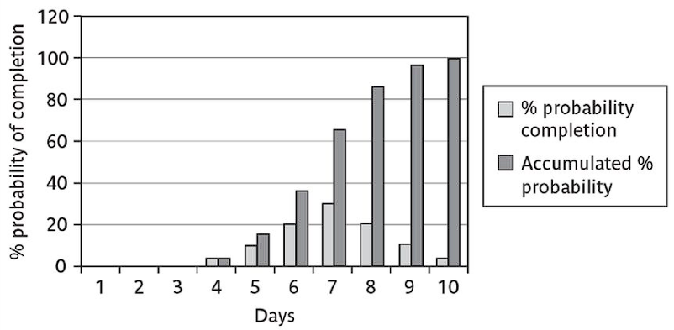
Probability chart
Notes:
Topics covered
Professional software development
What is meant by software engineering.
Software engineering ethics
A brief introduction to ethical issues that affect software engineering.
Suggested student projects
A brief introduction to each suggested project that can be carried out by students for this course

Slide 18
Using PERT to evaluate the effects of uncertainty
Three estimates are produced for each activity
Most likely time (m)
Optimistic time (a)
Pessimistic (b)
‘expected time’ t_{e} = (a + 4m +b) / 6
‘activity standard deviation’ S = (b-a)/6
Notes:
Topics covered
Professional software development
What is meant by software engineering.
Software engineering ethics
A brief introduction to ethical issues that affect software engineering.
Suggested student projects
A brief introduction to each suggested project that can be carried out by students for this course

Slide 19
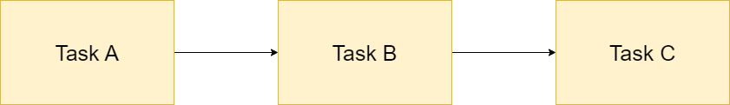
A chain of activities
Task | a | m | b | t_{e} | S
A | 10 | 12 | 16 | ? | ?
B | 8 | 10 | 14 | ? | ?
C | 20 | 24 | 38 | ? | ?
Notes:
Topics covered
Professional software development
What is meant by software engineering.
Software engineering ethics
A brief introduction to ethical issues that affect software engineering.
Suggested student projects
A brief introduction to each suggested project that can be carried out by students for this course

Slide 20
A chain of activities
What would be the expected duration of the chain A + B + C?
Answer: 12.66 + 10.33 + 25.66 i.e 48.65
What would be the standard deviation for A + B+ C?
Answer: square root of ( 1² + 1² + 3² ) i.e.
3.32
Notes:
Topics covered
Professional software development
What is meant by software engineering.
Software engineering ethics
A brief introduction to ethical issues that affect software engineering.
Suggested student projects
A brief introduction to each suggested project that can be carried out by students for this course

Slide 21
Assessing the likelihood of meeting a target
Say the target for completing A+B+C was 52 days (T)
Calculate the z value thus z = (T – t_{e})/s
In this example z = ( 52 – 48.33 )/3.32 i.e. 1.01
Look up in table of z values – see next overhead
Notes:
Topics covered
Professional software development
What is meant by software engineering.
Software engineering ethics
A brief introduction to ethical issues that affect software engineering.
Suggested student projects
A brief introduction to each suggested project that can be carried out by students for this course

Slide 22
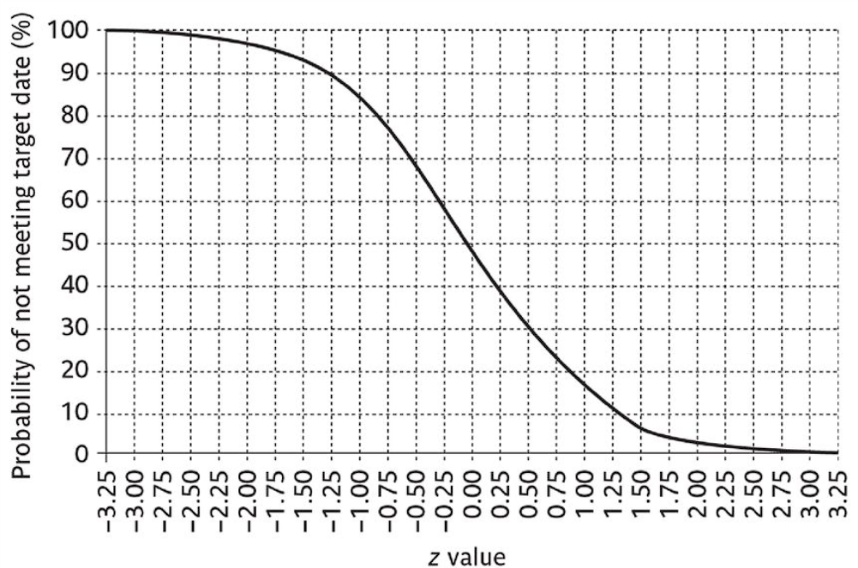
Graph of z values
Notes:
Topics covered
Professional software development
What is meant by software engineering.
Software engineering ethics
A brief introduction to ethical issues that affect software engineering.
Suggested student projects
A brief introduction to each suggested project that can be carried out by students for this course

Slide 23
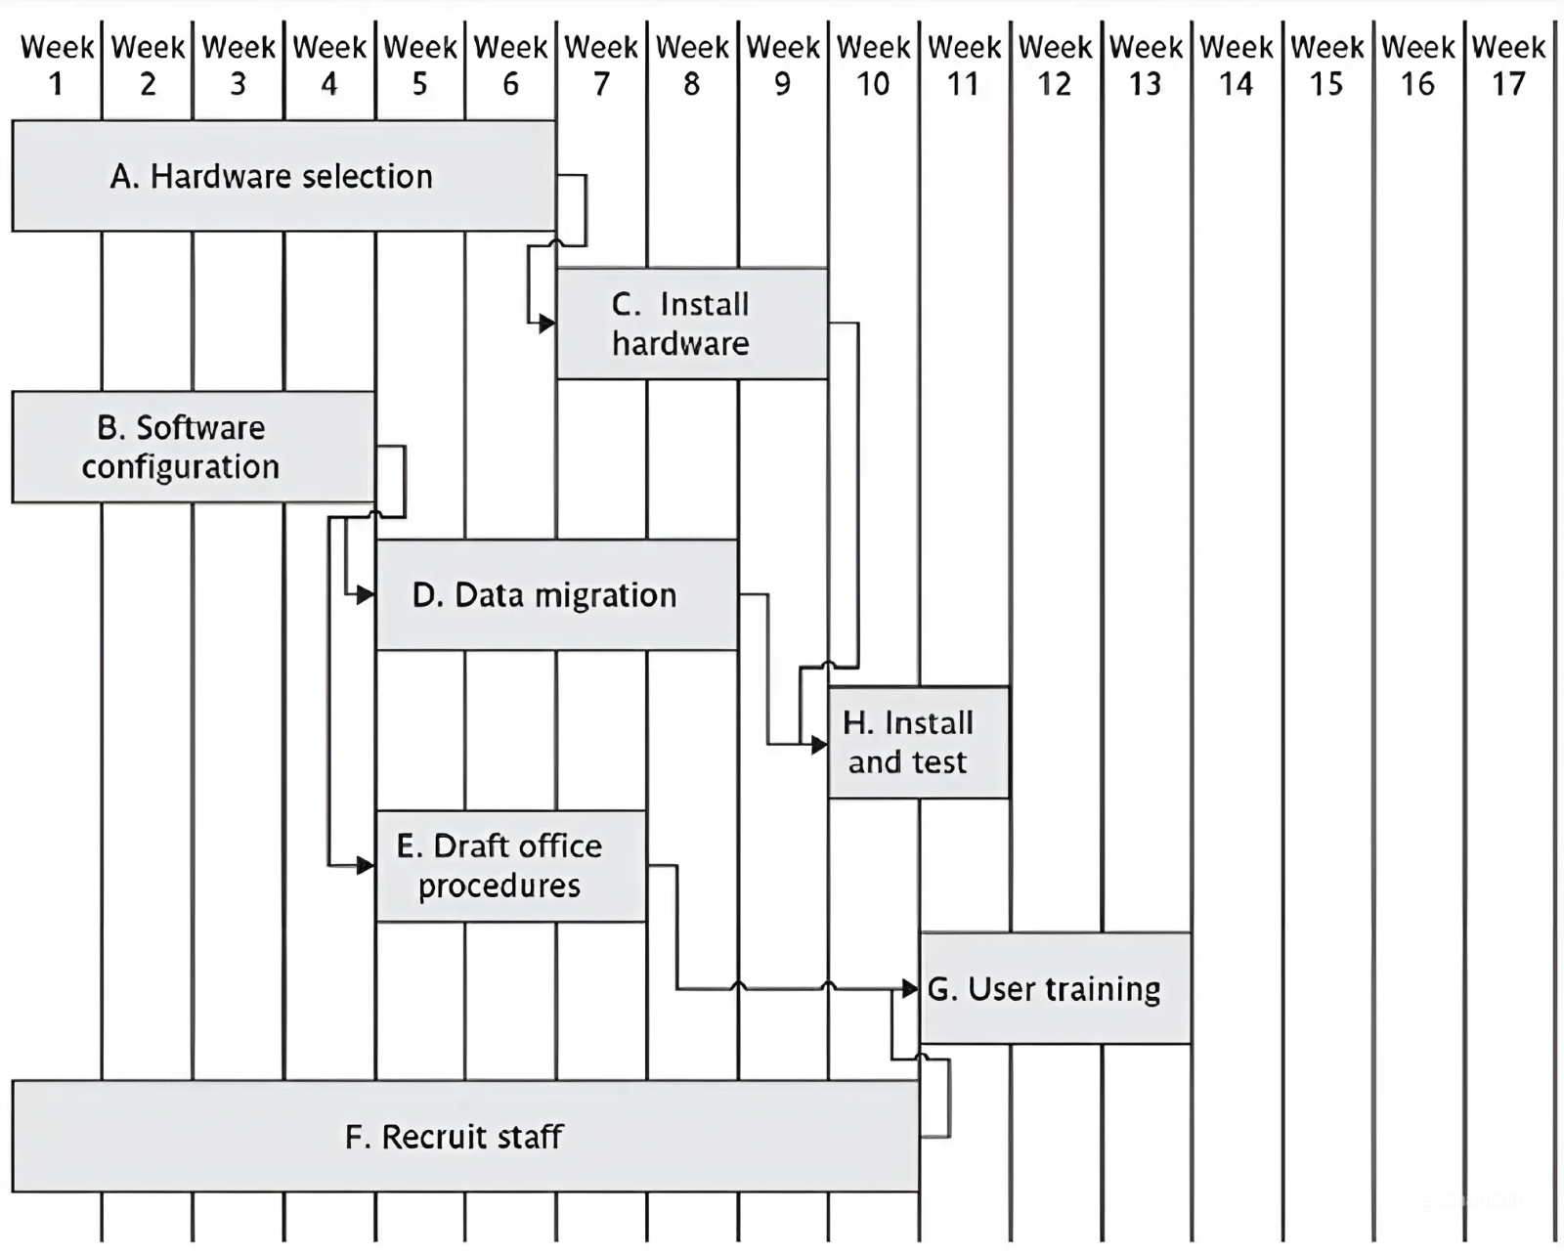
Critical chain concept
Traditional planning approach
Notes:
Topics covered
Professional software development
What is meant by software engineering.
Software engineering ethics
A brief introduction to ethical issues that affect software engineering.
Suggested student projects
A brief introduction to each suggested project that can be carried out by students for this course

Slide 24
Critical chain approach
One problem with estimates of task duration:
Estimators add a safety zone to estimate to take account of possible difficulties
Developers work to the estimate + safety zone, so time is lost
No advantage is taken of opportunities where tasks can finish early – and provide a buffer for later activities
Notes:
Topics covered
Professional software development
What is meant by software engineering.
Software engineering ethics
A brief introduction to ethical issues that affect software engineering.
Suggested student projects
A brief introduction to each suggested project that can be carried out by students for this course

Slide 25
Critical chain approach
One answer to this:
Ask the estimators for two estimates
  Most likely duration: 50% chance of meeting this
  Comfort zone: additional time needed to have 95% chance
Schedule all activities suing most likely values and starting all activities on latest start dates
Notes:
Topics covered
Professional software development
What is meant by software engineering.
Software engineering ethics
A brief introduction to ethical issues that affect software engineering.
Suggested student projects
A brief introduction to each suggested project that can be carried out by students for this course

Slide 26
Most likely and comfort zone estimates
Activity | Most likely | Plus comfort zone | Comfort zone
A | 6 | 8 | 2
B | 4 | 5 | 1
C | 3 | 3 | 0
D | 4 | 5 | 1
E | 3 | 4 | 1
F | 10 | 15 | 5
G | 3 | 4 | 1
H | 2 | 2,5 | 0,5
Notes:
Topics covered
Professional software development
What is meant by software engineering.
Software engineering ethics
A brief introduction to ethical issues that affect software engineering.
Suggested student projects
A brief introduction to each suggested project that can be carried out by students for this course

Slide 27
Critical chain - continued
Identify the critical chain – same a critical path but resource constraints also taken into account
Put a project buffer at the end of the critical chain with duration 50% of sum of comfort zones of the activities on the critical chain.
Notes:
Topics covered
Professional software development
What is meant by software engineering.
Software engineering ethics
A brief introduction to ethical issues that affect software engineering.
Suggested student projects
A brief introduction to each suggested project that can be carried out by students for this course

Slide 28
Critical chain -continued
Where subsidiary chains of activities feed into critical chain, add feeding buffer
Duration of feeding buffer 50% of sum of comfort zones of activities in the feeding chain
Where there are parallel chains, take the longest and sum those activities
Notes:
Topics covered
Professional software development
What is meant by software engineering.
Software engineering ethics
A brief introduction to ethical issues that affect software engineering.
Suggested student projects
A brief introduction to each suggested project that can be carried out by students for this course

Slide 29
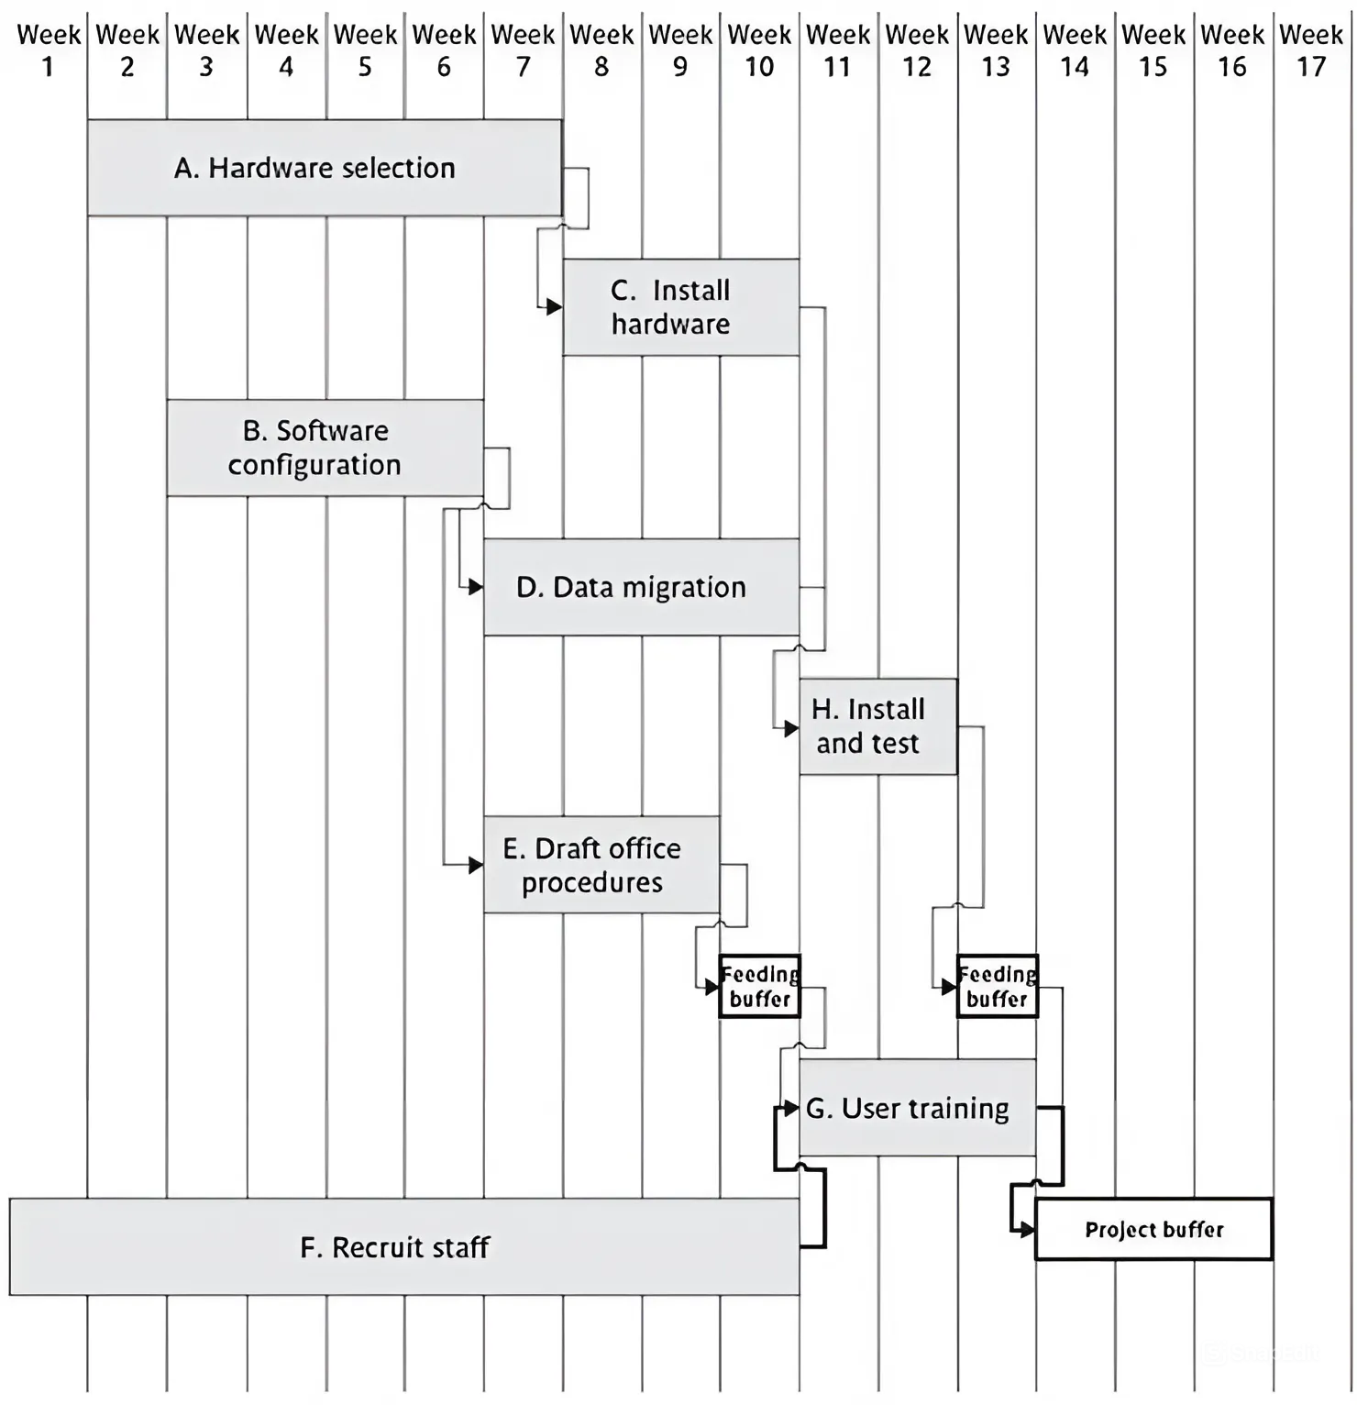
Plan employing critical chain concepts
Notes:
Topics covered
Professional software development
What is meant by software engineering.
Software engineering ethics
A brief introduction to ethical issues that affect software engineering.
Suggested student projects
A brief introduction to each suggested project that can be carried out by students for this course

Slide 30
Executing the critical chain – based plan
No chain of tasks is started earlier than scheduled, but once it has started is finished as soon as possible
This means the activity following the current one starts as soon as the current one is completed, even if this is early – the relay race principle
Notes:
Topics covered
Professional software development
What is meant by software engineering.
Software engineering ethics
A brief introduction to ethical issues that affect software engineering.
Suggested student projects
A brief introduction to each suggested project that can be carried out by students for this course

Slide 31
Executing the critical chain-based plan
Buffers are divided into three zones:
Green: the first 33%. No action required
Amber : the next 33%. Plan is formulated
Red : last 33%. Plan is executed.
Notes:
Topics covered
Professional software development
What is meant by software engineering.
Software engineering ethics
A brief introduction to ethical issues that affect software engineering.
Suggested student projects
A brief introduction to each suggested project that can be carried out by students for this course

